Slide 1
Presented by :
M.K.LINGESHWARMA
MCA - II

Slide 2
SEMINAR OVERVIEW
Understanding AI tools and their applications
Introduction to React: Concepts and fundamentals
Overview of popular React UI component libraries
How to integrate and use these tools effectively in web development

Slide 3
INTRODUCTION
Why AI tools are important in today’s tech ecosystem
Automate tasks & save time
Improve decisions with data
Enhance creativity & user experience
Why React is a go-to framework for modern UI development
Component-based & reusable
Fast with Virtual DOM
Widely used & easy to integrate
Connection between AI + React in real-world apps
Chatbots & voice assistants
Smart recommendations
AI-powered image/voice tools

Slide 4
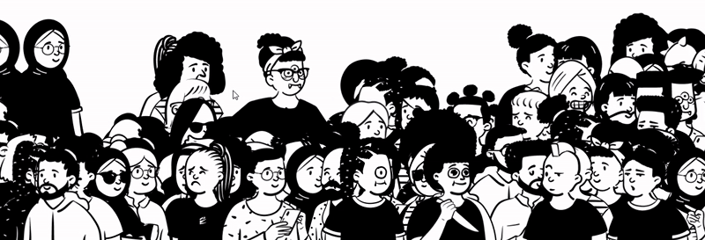
AI-TOOLS

Slide 5
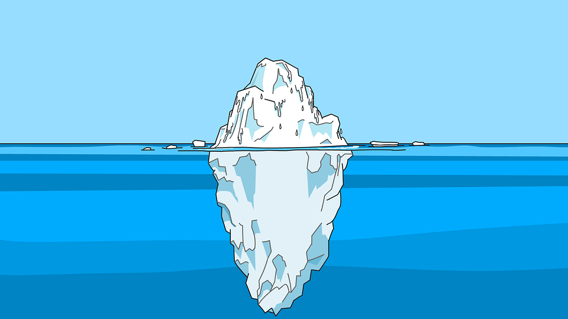













































































“
THERE IS A VAST AMOUNT OF AI TOOLS HIDDEN IN THE OCEAN OF THE INTERNET WHICH IS ONE SEARCH (DIVE) AHEAD

Slide 6


























































































BLACK BOX
BUBBLE
VITARA
AIR TABLE
QUICK
BASE
JIMDO
REPLIT
EMERGENT
SOFTGEN
CAPACITY
DORIK
SOFTR
KOMBAI
BOLT
LOVABLE
CODE
DESIGN
MIXO
SAME
CLAUDE
PYTHAGORA
ADALO
CODE
CONDUCTOR
THUNKABLE
PURE CODE
CREATE
SUPERBLOCKS(CLARK)
APPY PIE
YOU
ZENO
CHAT
CHARIOT
WORKIK
GLIDE
PERSONAL
UI BAKERY
MEMEX
APP MY SITE
UX PIN
UIZARD
RENDER
FOREST
SHOPNEY
RELUME
BASE 44
MERLIN
GROK
COPILOT
(MS)
VISILY
OPEN AI
PERPLEXITY
OLLAMA
(META)
CODIA AI
PI
STICH
UI 2 CODE
WEBWAVE
DURABLE
KITE
DEEPSEEK
TABNINE
TEMPO
GEMINI
FRONTY
VIBE
SOURCEGRAPH
CURSOR
LANG
CHAIN
FAB
WINDSURF
MINTLIFY
TUSK
MISTRAL
ADRENALINE
WRAP
CONDUCTOR
ASK CODI
BIND
HOCOOS
CODIUM (QODO)
POE
COPILOT
(GIT-HUB)
FIG
STACK
MUTABLE
CODE
RABBIT
TREA
V0 (zero)
BIT AND HOPE
PIECES
JETBRAINS
MANUS
BLOOP

Slide 7

REACT

Slide 8
INTRODUCTION TO REACT
React is a popular JavaScript library used for building user interfaces. It helps developers create fast and interactive web applications using reusable components.
React updates only the parts of the page that change, making apps efficient and easy to maintain. It uses JSX (a mix of HTML and JavaScript) and follows a component-based structure for better organization and reusability.
In short, React makes building modern, dynamic websites simpler and faster.

Slide 9

TOP-NOTCH REACT UI COMPONENTS

Slide 10











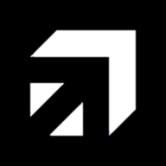



SHADCN
MAGIC UI
CHAKRA
REACT BITS
ANT DESIGN
ACETERITY
RADIX UI
HERO UI
MOTION PRIMITIVES
MVP BLOCKS
SHSF UI
KIBO UI
TWEAK CN
ANIMATE UI
SKIPER UI

Slide 11
THANK
YOU
BY
LW_19

